Slide 1
Leadership III for fire and ems: strategies for supervisory success
DELEGATING

Slide 2
OBJECTIVES
The students will:
Define delegation.
Identify the benefits derived from effective delegation.
Identify the barriers that prevent effective delegation.
Identify the nine principles of effective delegation.
Identify the consequences of reverse delegation.

Slide 3
OVERVIEW
What is Delegation?
Benefits of Delegation
Barriers to Delegation
Principles of Delegation
Reverse Delegation

Slide 4
What is Delegation?
Sharing of authority, responsibility, and accountability between two or more people

Slide 5
Authority is the right to make decisions and take action.

Slide 6
Responsibility is having an obligation to make decisions and take action.

Slide 7
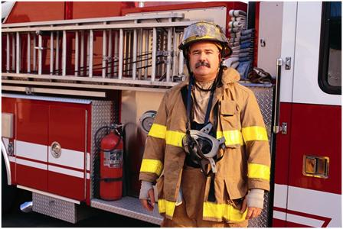
Accountability is having to answer for results.

Slide 8
What is Delegation?
Sometimes authority and responsibility are transferred.
More often, specific part of delegator's position is transferred.
Another person assumes responsibility for task(s) assigned to an individual at a higher level.

Slide 9
What is the definition of leadership?

Slide 10
What is Delegation? (cont'd)
Relationship to leadership:
Leadership--process of influencing others toward achievement of organizational goals.
Effective leadership requires development of subordinates in order to help them maximize their potential.

Slide 11
Activity DG.1 Benefits and Barriers

Slide 12
Benefits of Delegation
For the supervisor
More tasks accomplished in less time
Ability to concentrate on more critical tasks
Increased unit morale
Increased unit productivity
More effective leadership
Better time management

Slide 13
Benefits of Delegation (cont'd)
For the subordinate
Opportunity to increase job knowledge
Opportunity to develop leadership/ decisionmaking skills for future leadership roles
Increased motivation
Better understanding of organizational goals
Enhancement of self-confidence, self-esteem, and self-worth

Slide 14
Benefits of Delegation (cont'd)
For the organization
Better time management
More effective use of human resources-- better use of talent/skill/ability at all levels
Development of future leaders
Increased organizational effectiveness

Slide 15
Barriers to Delegation
Believing it's wrong to let subordinates do your assigned work
Fear that subordinates will show you up
Believing you can do it better and faster
Lack of confidence in subordinates
Unwillingness to let go of favorite tasks
Fear of losing control
Fear that subordinates will fail and you'll look bad
Lack of self-confidence

Slide 16
Barriers to Delegation (cont'd)
Effective leaders--responsible for getting the job done
Not necessarily doing it all themselves
When job well done, no matter who did it, leader looks good

Slide 17
Barriers to Delegation (cont'd)
Effective leaders-- committed to maximizing potential of each subordinate
All tasks are not equal
You do things more often
Help subordinates grow
Effective leaders-- understand process of delegating
Basic principles
Minimize risk of potential failure
Increased self- confidence

Slide 18
Principles of Delegation
Delegate the right task
Don't delegate:
-- Obvious supervisor-to-subordinate responsibilities
-- Tasks that involve confidential information
-- Tasks that involve great risk
-- Tasks that the organization and/or your supervisor expects you to do yourself

Slide 19
Principles of Delegation (cont'd)
Consider delegating tasks:
That are routine
You've been putting off due to lack of time
You've been wrestling with unsuccessfully
Unexpected, unplanned requirement that will interrupt other projects
A "royal headache" for you but will be "fun" for someone else

Slide 20
Principles of Delegation (cont'd)
Use the following process to select the "right" tasks:
List all tasks you presently perform
Evaluate each task for potential delegation based on the criteria provided
Select one or two tasks you are willing to try delegating

Slide 21
Principles of Delegation (cont'd)
Which subordinate is competent?
Is the person ready?
Is the person self-confident enough to assume new responsibilities?
If the task requires working with or leading others, does the person have sufficient credibility?

Slide 22
Principles of Delegation (cont'd)
Define responsibility--what's involved
Clearly define the limits of responsibility being transferred
Make sure the person understands exactly what's involved
Meet up and cover the following

Slide 23
Principles of Delegation (cont'd)
Define the task: specify
Exactly what must be done?
How much?
How well?
When?
Who else?

Slide 24
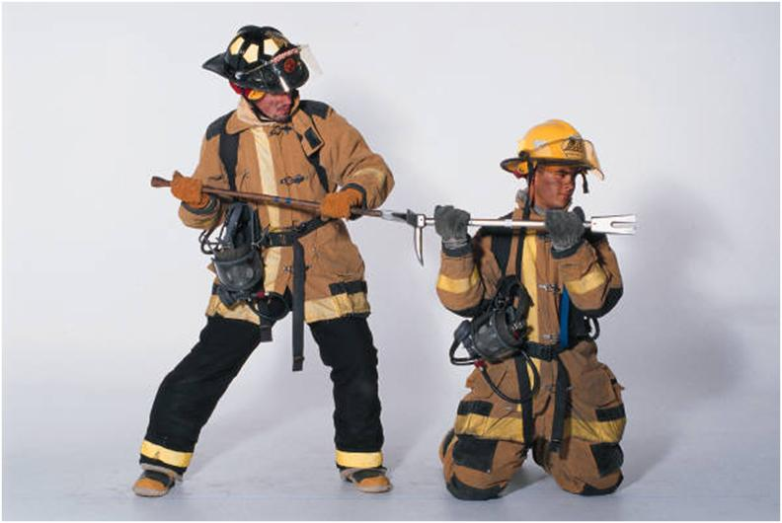
Sharing Knowledge

Slide 25
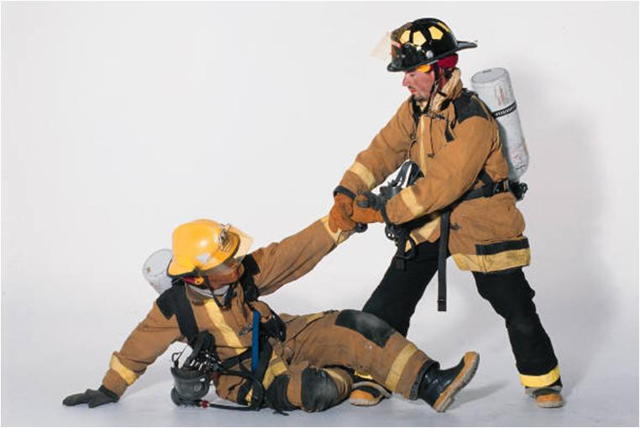
Provision for Training as Appropriate

Slide 26
Principles of Delegation (cont'd)
Provide necessary information
Background
Why task is necessary
Relevant material
Sources of additional information
Provide or arrange for any necessary training
Emphasize your confidence in the ability to do the delegated task

Slide 27
Principles of Delegation (cont'd)
Delegate authority
Authority makes decisions and takes action
Clearly define limits of authority being transferred
Examples of degree of authority:
-- Take action only after clearing with supervisor
-- Take action and complete reported action to supervisor
-- Take action

Slide 28
Principles of Delegation (cont'd)
Limited to actions/decisions related to delegated task.
Amount of authority must match amount of responsibility.
If delegated task requires the person to interact with/lead others, you must advise them of the delegatee's authority.

Slide 29
Principles of Delegation (cont'd)
Get agreement
Allow subordinate an opportunity to accept or refuse the assignment
Can't force someone to do job outside of their description
Subordinate should want the assignment
Make sure delegatee understands what's involved

Slide 30
Principles of Delegation (cont'd)
Demand accountability
Having to answer for results
Final product must be evaluated against expected results
Make sure each person knows what they are accountable for

Slide 31
Principles of Delegation (cont'd)
Establish feedback mechanisms
Milestone dates
Check-ins
Frequency of feedback determined by:
-- Complexity
-- Importance
-- Confidence
Supervisor needs to strike a balance

Slide 32
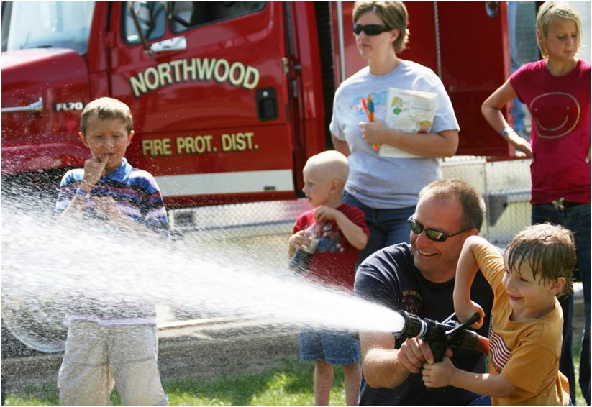
Supervisory Retreat

Slide 33
Principles of Delegation (cont'd)
Provide for emergencies
Supervisor must "let go"
Avoid tendency to "jump in and take over"
Allow subordinate to correct mistakes without interference
Subordinate may approach task in different way
"Let go," but don't "drop out" completely
Minimal supervision with "open door" policy

Slide 34
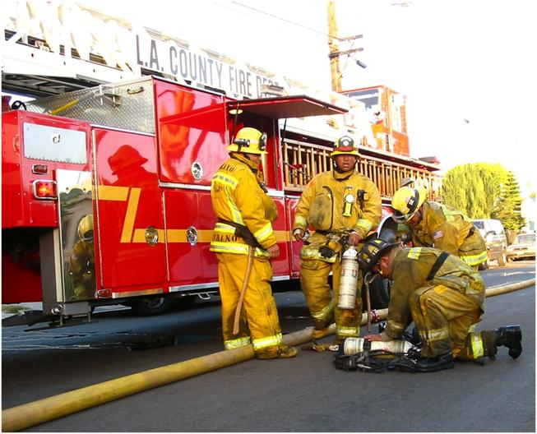
Leaving Subordinates Alone

Slide 35
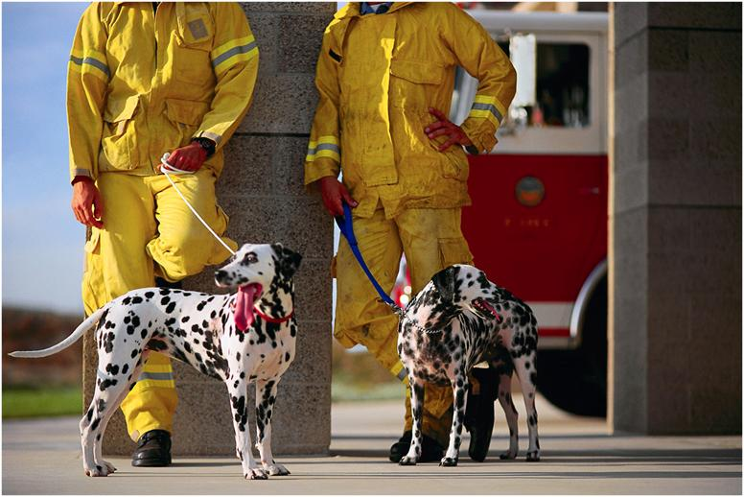
Tolerating Differences

Slide 36
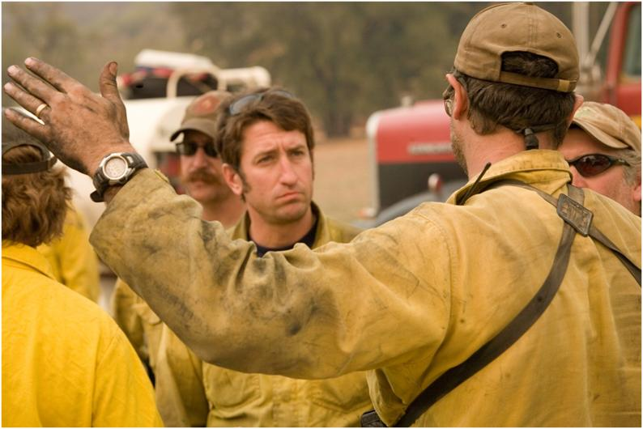
Showing Interest without Nosiness

Slide 37
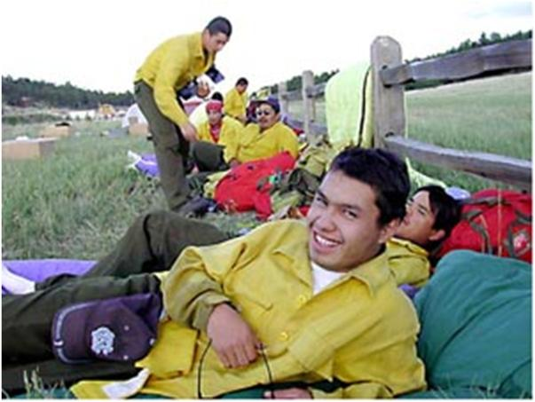
REWARDING A JOB WELL DONE

Slide 38
Principles of Delegation (cont'd)
Reward accomplishments
Provide positive reinforcement
Reward for final products that meet or exceed criteria established at time of initial delegation
Provide constructive feedback if final product failed to meet performance criteria
Solicit feedback from subordinate on the total delegation process

Slide 39
Activity DG.2 Evaluating the Delegating Process

Slide 40
Reverse Delegation
Occurs when a supervisor accepts responsibility for a task that rightfully belongs to a subordinate.
Going up, instead of down.
Subordinate cleverly manipulates supervisor.

Slide 41
Reverse Delegation (cont'd)
Consequences of reverse delegation
Takes time away from tasks supervisor is required to do
Rewards subordinate for unacceptable performance
Reduces supervisor's leadership credibility
Prevents subordinate growth and development

Slide 42
Reverse Delegation (cont'd)
How to avoid
When a subordinate does a task incorrectly, provide feedback and/or training as needed, but give it back for revision.
If a subordinate comes to you for help, give whatever help is required, but don't just do the job yourself.
Always be available for help and support, but refuse to accept ownership of subordinate tasks.

Slide 43
Summary
Principles of delegation process
Taking the first step
Success depends on:
-- Knowing yourself
-- Knowing your subordinates
-- Following the basic rules
-- Taking your time
-- Believing you can do it

Slide 44
Summary (cont'd)
The payoff
Supervisor and subordinates grow.
Morale and profitability increase.

